Slide 1

MEDICAL PRESCRIPTION WRITING ROBOT
C16
DOMAIN-EMBEDDED
SUBITHA VARSHINI.V -211417104271
VENNILA.D - 211417104297
HARITHA.V - 211417104319
GUIDE : Mrs.P.Deepa, M.E.,
Associate Prof., Department of CSE
Panimalar Engineering College

Slide 2
ABSTRACT
The approach is to design rapid and fluid movements of a universal robot to perform robot writing mimicking the doctor prescription writing when signing and the trajectory.
Reading a doctor’s handwritten prescription is a challenge that most patients and some pharmacists face; an issue that, in some cases, this lead to negative consequences due to wrong deciphering of the prescription. Part of the reason why doctor's prescriptions are so difficult to decipher is that doctors make use of Latin abbreviations and medical terminology that most people don't understand.
To perform the task, on-line human signing standards are created first. Robot writing task is performed using these standards after that and robot signatures are acquired as a result. Finally, recommendations of robot motion improvement are given.

Slide 3
LITERATURE SURVEY
TITLE OF THE PAPER | AUTHOR NAME | METHODOLOGY | DISADVANTAGES
Digitalization of Medical Prescription International Research Journal of Engineering and Technology(IRJET) mar 2018 | Ananthu T .S1 Athira Jayan2 Felna Francy Chazhoor3 Linnet Tomy4 | Personal Digital Assistant(PDA) | At the beginning itself the product cannot give its full productivity
Development Of Smart Medical Prescription Service Model Conference paper sep 2018 | Bijoya Lalaa Sabikun Naherb Mohammed Arif I Mahmoodc Md. Murshadul Hoqued | Website structure and Database management scenario SMPS development flowchart | The diagnostic center can view only physical examination test section of prescription written by the doctor

Slide 4
TITLE OF THE PAPER | AUTHOR NAME | METHODOLOGY | DISADVANTAGES
An Electronic Prescription System powered by Speech Recognition, Natural Language Processing and Blockchain Technology International Journal Of Scientific & Technology Research August 2019 | Jitendra Mahatpure Dr Mahesh Motwani Dr Piyush Kumar Shukla | Hyperledger Composer Blockchain Network Node.js REST APIs Python Django REST APIs React-Native Mobile Application React JS Web Application | The system in the real hospital ecosystem to test and validate the implementation and to analyze the impact it will create in the healthcare domain is worse
Web Controlled Surveillance Robot International Journal of Emerging Technology and Advanced Engineering October 2015 | Devjyoti Ghosh1 Shaarang Sahanie2 Shreyas Bhandari3 Vedant Shirali4 Mudit Kapoor5 | Android Implementation Chassis Implementation Network Implementation | An android map with a microcontroller that will enable us to use the GPS and send the robot to a specific location by choosing the path from the map

Slide 5
TECHNOLOGY STACK HARDWARE REQUIREMENTS SOFTWARE REQUIREMENTS
ATMega328 MICRO CONTROLLER
Bluetooth Module
Liquid Crystal Display
Stepper Motor Driver
Stepper Motors and Servo Motor
Gear and Belt Setups
Adapter
5*1 Keypad
Embedded C
Android Application
AVR IDE

Slide 6
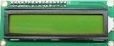
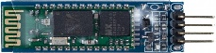
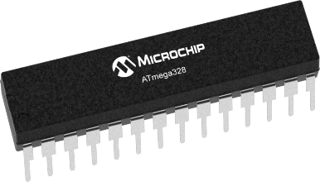
SYSTEM ARCHITECTURE
RECEIVER SECTION
TRANSMITTER
SECTION

Slide 7
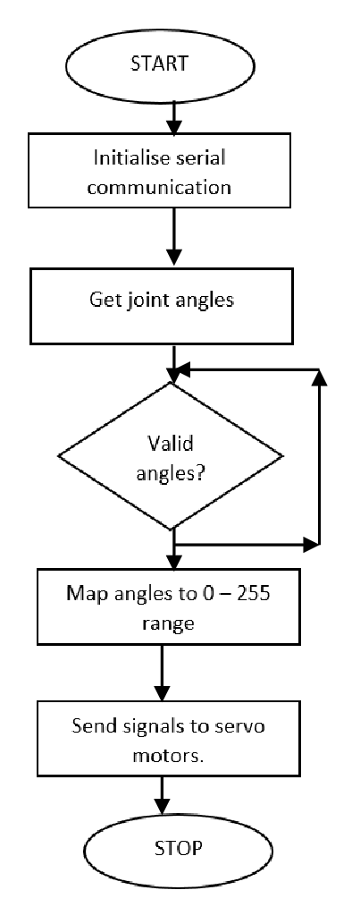
SYSTEM DESIGN
FLOW DIAGRAM

Slide 8
USECASE DIAGRAM
LOGIN
USER
Recognize
User Voice
Transfer via Bluetooth
Bluetooth Module
ROBOT
Writes prescription

Slide 9
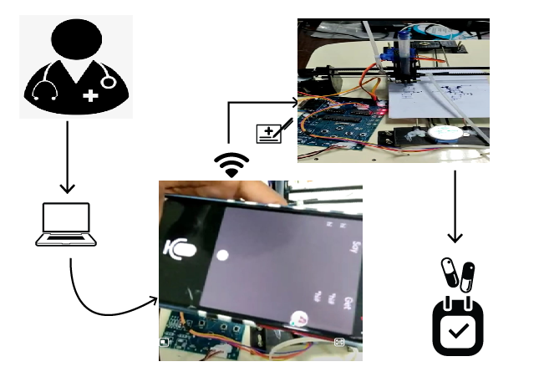
PROCESS FLOW DIAGRAM

Slide 10
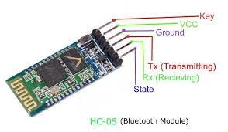
MODULES DESCRIPTION
BLUETOOTH MODULE :
HC-05 Bluetooth Module is responsible for enabling Bluetooth Communication between Arduino in the kit and the Android Phone, for transparent wireless serial connection setup.
User can give various commands and these commands are sent from the Android mobile to the Bluetooth receiver.

Slide 11
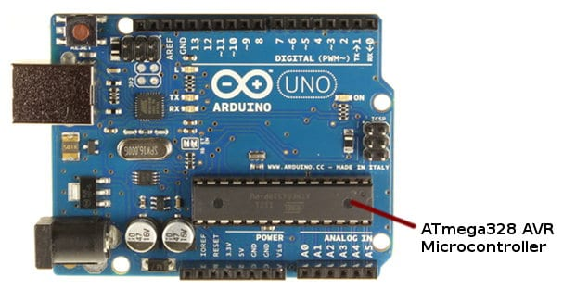
ATMega328 MICRO CONTROLLER :
ATmega328 micro controller is used because of its high performance and low power consumption and also it is of low cost and high compatibility with Arduino boards.
ATmega328 on the Arduino comes pre-programmed with a bootloader that allows you to upload new code to it without the use of an external hardware programmer.

Slide 12
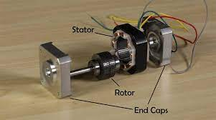
STEPPER MOTOR :
Stepper motor can be commanded to hold the robot at a certain position as long as you want or you can just put a program to control the movements.
Stepper motor makes the robot to respond and accelerate quickly. They have low rotor inertia that can get up to speed quickly and so that it is ideal for short, quick moves.
One of the most remarkable features of using step motor is its precision, accuracy and low cost.

Slide 13
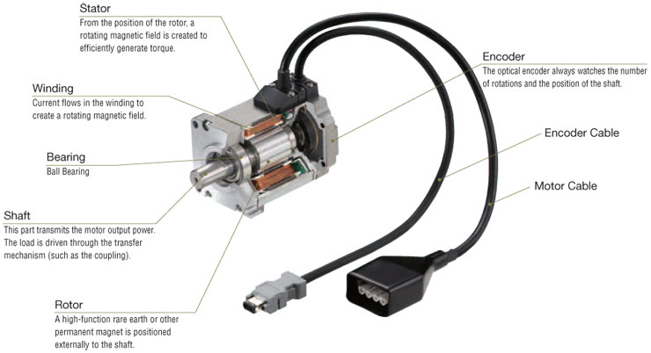
SERVO MOTOR :
A servo motor’s position, velocity and torque can be controlled as required which is necessary for the robotic movement.
Servo motors are much lighter, so that the robot stands upright and maintain its balance when moving.
A regular motor(AC or DC motor) always rotate in 360 degrees but servo motor can rotate in 0 to 180 degree.

Slide 14
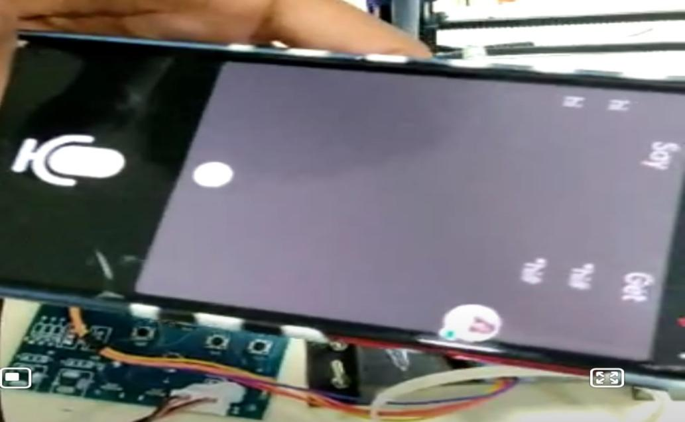
SCREENSHOTS OF WORKDONE
VOICE RECOGNITION

Slide 15
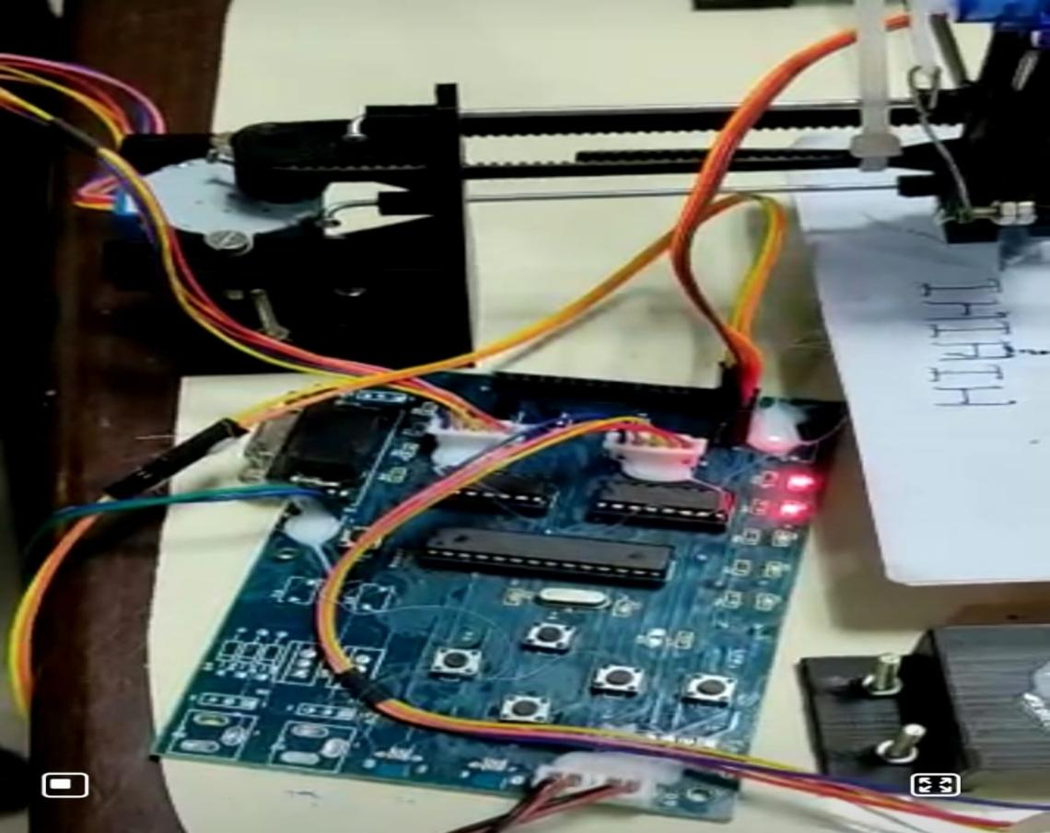
CONTROL SWITCHES

Slide 16
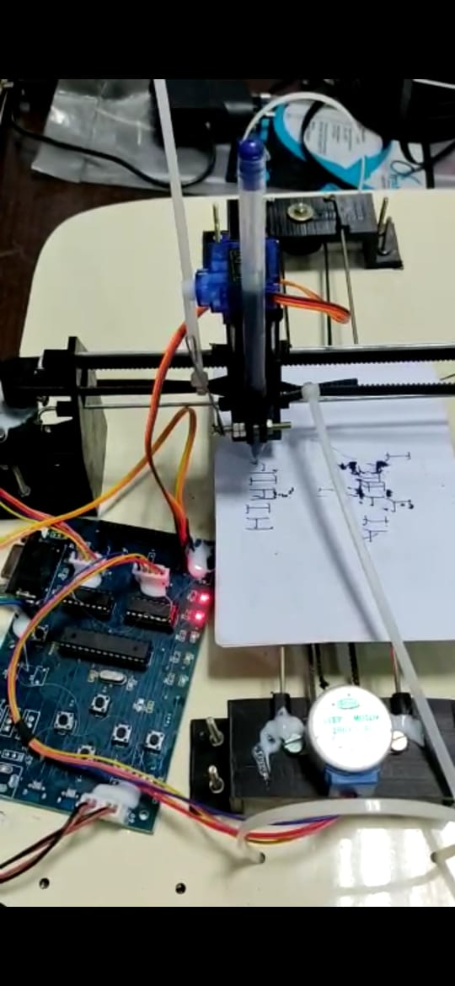
PRESCRIPTION WRITING

Slide 17
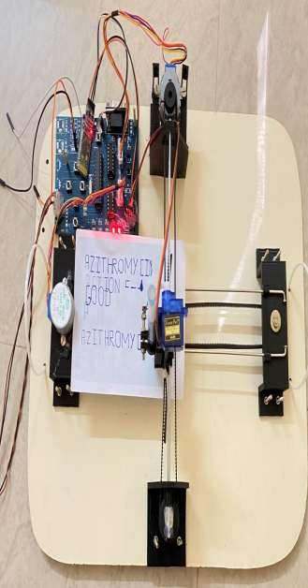
FULL HARDWARE MODULE

Slide 18
ADVANTAGES
Automation is implemented and thus the data collection and analysis is made easier
Accuracy
Optimized character axis
Cost effective approach
Time consumption is saved

Slide 19
FUTURE SCOPE
In our project the writing speed is slow since we use the servo motor. So, In order to increase the speed we can use the DSP (Digital Signal Processing) in future if needed. Even it can be used for handicapped people during their examination. The people who can’t write can use this instead of depending on some other people.

Slide 20
CONCLUSION
Our approach is to discover a robot that can write a medical prescription what doctor says in mobile app, so that the patients and the pharmacists can understand what is written in the prescription. now the patients can take the correct medicine and the pharmacist can give the right medicine. we present a method to design rapid and fluid movements of a universal robot to perform robot writing mimicking the kinematics and trajectory of human handwritten signatures. The handwriting specimen acquisition, writing specimen processing, robot writing and comparison of on-line human and robot signatures are the phases of the experimental research performed.

Slide 21
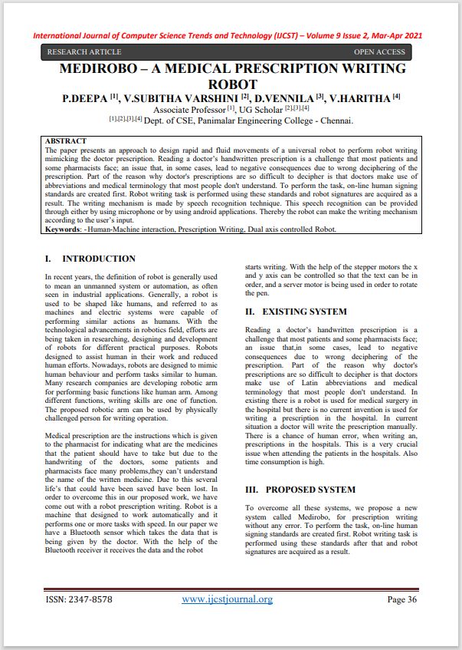
PUBLICATIONS
Journal Name : IJCST
Title : MEDIROBO - A Medical Prescription
Writing Robot
Volume : Volume 9
Issue : Issue Number 2
Year : 2021
Link : http://www.ijcstjournal.org/current-issue.html

Slide 22
REFERENCES
[1] Roger Achkar, Khodor Ghayad, Rayan Haidar, Swasan Saleh, Rana Al Hajj,”Medical Handwritten Prescription Recognition Using CRNN “,IEEE (2019).
[2] Kanstantsi Miatliuk,Adam Wolniakkowski,Moises Diaz,Jose J.Quintana,Miguel A.Ferrer,”Universal Robot Employement to mimic human writing”,IEEE(2019).
[3] B. Moysset, C. Kermorvant, and C. Wolf proposes“Full-page text recognition: Learning where to start and when to stop,”arXiv: 1704, 08628, 2017.
[4] T. Bluche demonstrates“Joint line Segmentation and transcription for end-to- end handwritten paragraph recognition,” in Advances in Neural Information Processing Systems, 2016, pp.
[5] P. Voigtlaender, P. Doetsch, and H. Hey publish about “Handwriting recognition with large multidimensional long short-term memory recurrent neural networks,” in Frontiers in Handwriting Recognition inyear 2016.15th international Conference on. IEEE, 2016.

Slide 23
[6] Youssef Harkouss and Roger Achkar have published a paper “The Accurate wavelet neural network for the efficient controlling of an active magnetic bearing system” 2010.
[7] George Abou Kassm and Roger Achkar demonstrates Apr cnn cascade and adaptive deskewing. Procedia Computer Science, 114:296–303, 2017.
[8] M. Diaz, M. A. Ferrer and J.J. Quintana. "Robotic Arm Motion for Verifying Signatures". 16th International Conference on Frontiers in ICFHR,, USA, 5-8 August 2018.
[9] C. Valsamos, A. Wolniakowski, K. Miatliuk, V.C. Moulianitis proposed the Minimization of joint velocities during the execution of a robotic task byarticulated manipulator, Advances in Service and Industrial Robotics, Mechanisms and Machine Science, Springer, vol. 67, 2018, pp. 368-375.
[10] Dr. Nomal Chandra Borah, Chairman & Managing Director published there paper in Guwahati Neurological Research Centre. Doctor’s illegiblehandwriting creating confusion leads to deathon April 20, 2015

Slide 24


